Slide 1
NICKEL-CADMIUM BATTERY

Slide 2
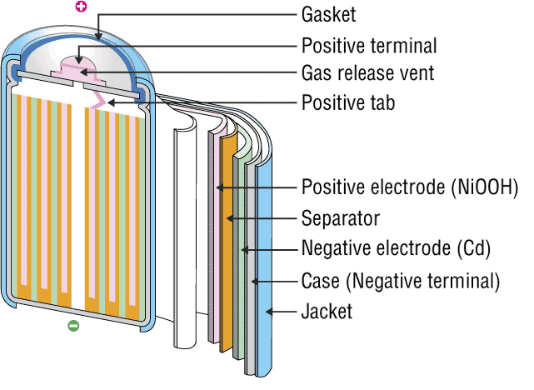
INTRODUCTION
The nickel–cadmium battery is a type of rechargeable battery using nickel oxide hydroxide and metallic cadmium as electrodes. Ni-Cd batteries are made in a wide range of sizes and capacities.
Nickel(hydroxide)–cadmium systems are the most common small rechargeable battery type for portable appliances. The sealed cells are equipped with “jelly roll” electrodes, which allow high current to be delivered in an efficient way. These batteries are capable of delivering exceptionally high currents, can be rapidly recharged hundreds of times, and are tolerant of abuse such as over discharging or overcharging.
It produces a voltage of about 1.4 V

Slide 3
INVENTIONS AND SCOPE
Nickel-cadmium (NiCd)
Invented by Waldemar Jungner in 1899. Developments were slow, but in 1932, advancements were made to deposit the active materials inside a porous nickel-plated electrode. Further improvements occurred in 1947 by absorbing the gases generated during charge, which led to the modern sealed NiCd battery.
For many years, NiCd was the preferred battery choice for two-way radios, emergency medical equipment, professional video cameras and power tools. In the late 1980s, the ultra-high capacity NiCd rocked the world with capacities that were up to 60 percent higher than the standard NiCd.
Since the disposal of battery is hazardous to environment alternative cells are being used such as paper battery

Slide 4
RECENT TRENDS
The primary trade-off with Ni–Cd batteries is their higher cost and the use of cadmium. This heavy metal is an environmental hazard, and is highly toxic to all higher forms of batteries.
Recently, nickel–metal hydride and lithium-ionbatteries have become commercially available and cheaper, the former type now rivaling Ni–Cd batteries in cost..
The batteries are more difficult to damage than other batteries, tolerating deep discharge for long periods.
Ni–Cd batteries typically last longer, in terms of number of charge/discharge cycles, than other rechargeable batteries such as lead/acid batteries.
Compared to lead–acid batteries, Ni–Cd batteries have a much higher energy density.
In consumer applications, Ni–Cd batteries compete directly with alkaline batteries. A Ni–Cd cell has a lower capacity than that of an equivalent alkaline cell, and costs more.
The capacity of a Ni–Cd battery is not significantly affected by very high discharge currents.

Slide 5
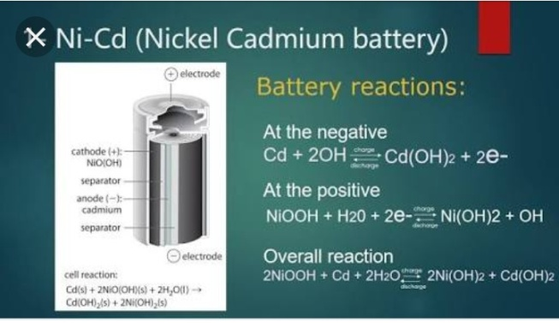
CELL REPRESENTATION AND CELL REACTION
A typical Ni-Cd battery is represented as
Cd| Cd(OH)2|| NiO(OH)| Ni(OH)2
Cell reaction while discharging
At Anode: oxidation of Cd metal
Cd + 2OH_ Cd(OH)₂ + 2e⁻
At cathode: reduction of NiO(OH)
2NiO(OH) + 2H₂O + 2e⁻ 2Ni(OH)₂ + 2OH⁻
Net Cell reaction:
2NiO(OH) + 2H₂O + Cd 2Ni(OH)₂ + Cd(OH)₂

Slide 6
ADVANTAGES
Fast and simple charging process
It is compact and lighter than traditional batteries
It has a longer life than lead storage batteries
Available in a wide range of sizes and performance options
Good low-temperature performance
Only battery that can be ultra-fast charged with little stress

Slide 7
LIMITATIONS
It is rather more expensive than a lead storage battery
It has a lower energy density value
Cadmium is a toxic metal. Cannot be disposed of in landfills
Memory effect; needs periodic full discharges
High self-discharge; needs recharging after storage

Slide 8




APPLICATIONS
Ni-Cd cells are popularly used in many appliances because they are available in variety of sizes and capaciities.
Few examples are:
Calculators
Electronic flash units
Transistors
Cordless appliances

Slide 9
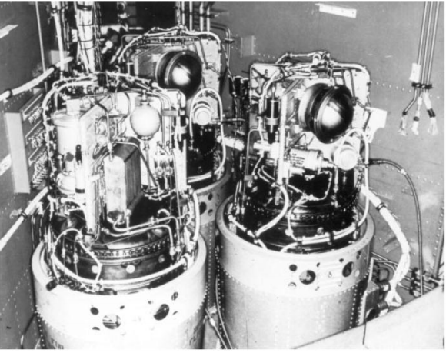
FUEL CELLS

Slide 10
FUEL CELLS
A fuel cell is an electrochemical device that produces electricity without combustion by combining hydrogen and oxygen to produce heat and water

Slide 11
History of Fuel Cells
Discovered by German scientist G.H.Shoenbein.
First developed by William Grove.
Developed by Grove while conducting research on electrolysis.
Between 1930s to 1950s, British engineer Francis Thomas Bacon worked on developing alkaline fuel cells.
He demonstrated a working stack in 1958
The technology was licensed to Pratt and Whitney where it was utilized for Apollo spacecraft fuel cells

Slide 12
Advantages of Fuel Cells over conventional energy sources
They produce zero or very low emissions, especially Green House Gases depending on the fuel used.
Efficiency of fuel cells is more than efficiency of conventional heat engines.
They have an excellent response time.
They require minimal maintenance.
No recharging is required.

Slide 13
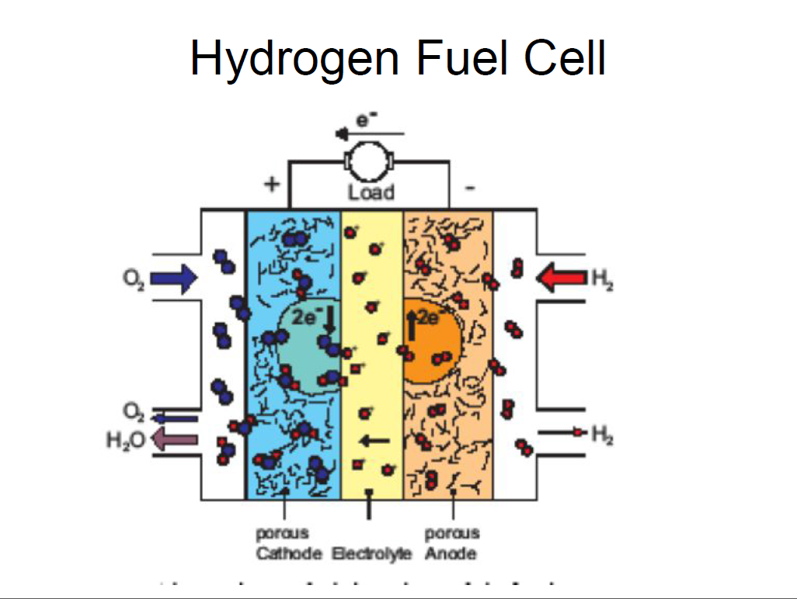
Structure of Hydrogen fuel cell
2H₂ + 4OH – _{(aq)} → 4H2O
O₂ + 2H₂O + 4e⁻ → 4OH⁻
-------------------------------------------------
2H₂ + O₂ → 2H₂O

Slide 14
Working Principle-
A fuel cell is a device which uses Hydrogen (or a hydrogen rich fuel) and oxygen to create electricity by an electrochemical process.
A single fuel cell consists of an electrolyte sandwiched between two electrodes (a porous anode and cathode.)
Hydrogen or a hydrogen rich fuel is fed to the anode where a catalyst separates hydrogen’s negatively charged electrodes from positively charged ions (protons).
At the cathode, the oxygen combines with the electrons and, in some cases, with species like protons or water, resulting in water or hydroxide ions, respectively.

Slide 15
The electrons from anode side of the cell cannot pass through the membrane to the positively charged cathode; they must travel around it via an electrical circuit to reach the other side of the cell. The movement of the electrons is an electrical current
This is how generation of electric current takes place via a fuel cell

Slide 16
Factors on which Power generated depends
The power generated by fuel cell depends on factors such as:
Fuel cell type.
Cell size.
Temperature at which it operates.
Pressure at which the gases are supplies to the cell.

Slide 17
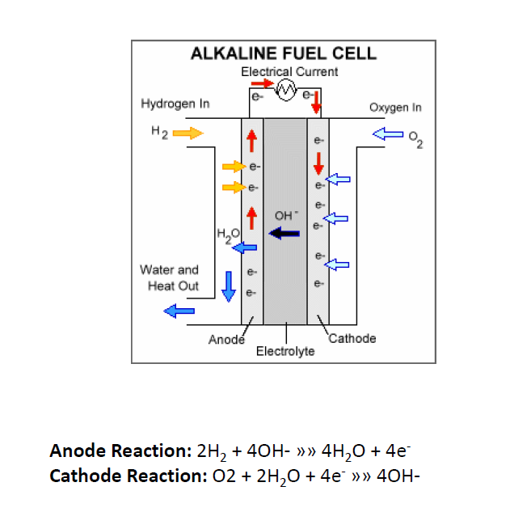
Diagram of an alkaline fuel cell

Slide 18
Alkaline fuel cells
Alkaline fuel cells use an alkaline electrolyte such as 40% aqueous potassium hydroxide.
In alkaline fuel cells travel through the electrolyte to the anode where they combine with the anode to form water and electrolyte
These fuel cells use a solution of potassium hydroxide in water as the electrolyte and can use a variety of non precious metals as a catalyst at the anode and cathode.
High temperature AFCs operate between 373K-523K.
However more recent AFCs operate at lower temperatures between 296K-343K.

Slide 19
Advantages
The efficiency is as high as 60%
Cathode reaction is faster in an alkaline electrolyte; thus leading to high performance.
Disadvantages
This cell is easily poisoned by CO2.
Even the smallest amount of CO2 in air can affect the performance of the cell’s operation, making it necessary to purify both the hydrogen and oxygen used in the cell.
Susceptibility to poisoning reduces cell’s lifetime.

Slide 20
Applications of fuel cells
Fuel cells are very useful in remote locations, such as spacecraft, remote weather stations, rural locations including research stations, and in certain military applications.
As of 2015, two fuel cell vehicles have been introduced in commercial market in limited quantities: the Toyota Mirai and the Hyundai ix35 FCEV. Additional demonstration models include the Honda FCX Clarity, and Mercedes-Benz F-Cell

Slide 21
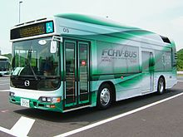
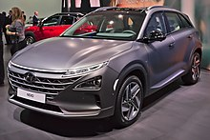
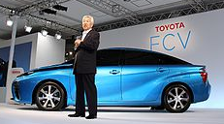
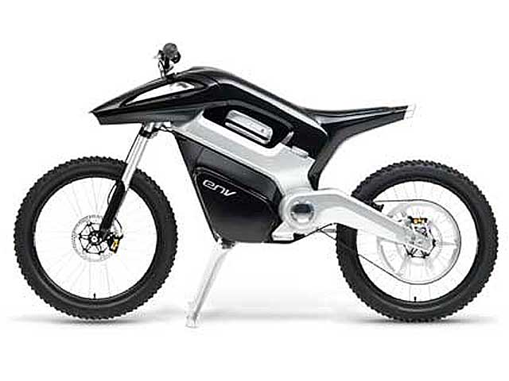
As of August 2011, there were a total of approximately 100 fuel cell buses deployed around the world.
In 2013 there were over 4,000 fuel cell forklifts used in material handling in the US.
In 2005 a British manufacturer of hydrogen-powered fuel cells, Intelligent energy, produced the first working hydrogen run motorcycle called the Emission Neutral Vehicle. The motorcycle holds enough fuel to run for four hours, and to travel 160 km (100 mi) in an urban area, at a top speed of 80 km/h (50 mph)
Toyota Mirai
Hyundai Nexo

Slide 22
Advantages of fuel cells
Hydrogen being the most abundant element in the universe, makes hydrogen fuel cells more viable
Hydrogen has the highest energy content.
Hydrogen is non polluting
Reduces dependency on fossil fuels

Slide 23
Disadvantages of fuel cells
Hydrogen is very expensive, not because it is rare but because its difficult to generate, handle and store requiring bulky tanks like those for CNG.
It can be stored at moderate temperatures and pressures in a tank containing a metal-hydride absorber or or carbon absorber, but both of these are very expensive.
Fuel cells are often very bulky and can not be used everywhere.
The actual cells in which power generated is stored can store only a small amount of power. This reduces the reliability of the entire process

